Slide 1

The Third Wave: Addressing Global Imbalances
8 September 2026
Report by Bai, Gopinath, Rey, and Weber (March 2026)
Gita Gopinath
Gregory and Ania Coffey Professor of Economics
Harvard University
Prepared for the Macro Policy Seminar (Harvard University)

Slide 2
The Third Wave of Global Imbalances
1
2
GFC
3
Plaza Accord
Source: IMF WEO (April 2026)

Slide 3
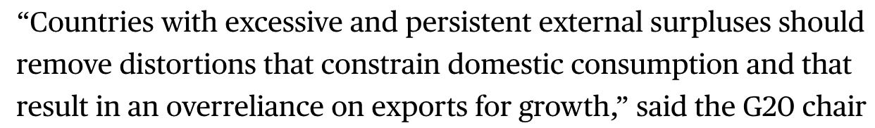
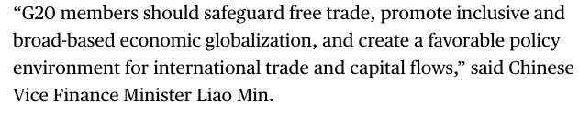
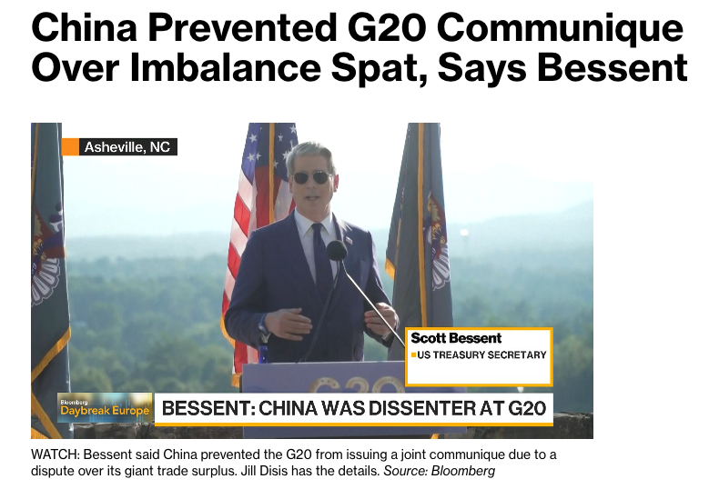
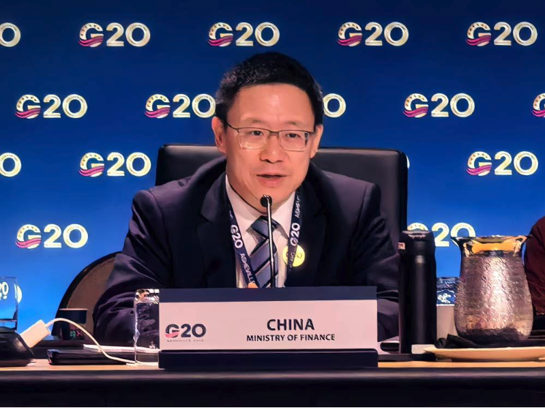

Slide 4
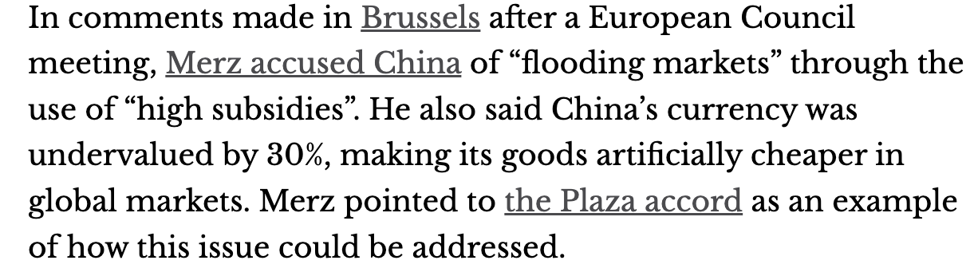
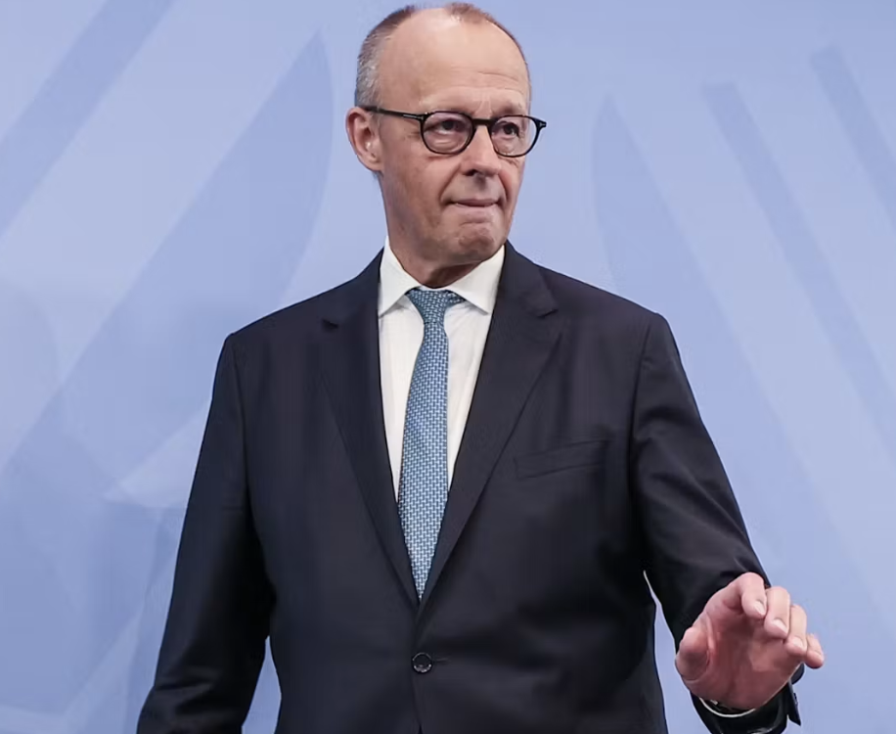

Slide 5
I. How to tackle this third wave?
Past cycles of global imbalances associated with rise of protectionism and/or financial crises.

Slide 6
How to address global imbalances? Lining up the proposals
1 | 2 | 3 | 4 | 5
Domestic macro adjustments: China raises HH consumption US reduces fiscal deficits | Revalue Yuan (Plaza accord) | Tariffs | Industrial Policy | Degrade dollar’s reserve currency status

Slide 7
Some useful definitions
Current account balance (CA)
= National savings (S) – national investment (I)
= (Private S – Private I) + (Public S – Public I)
= Trade balance (TB) + Net factor income from abroad (NFIA)
Notes:
A current account deficit is not just a trade imbalance — it reflects a gap between domestic saving and investment and is financed by net capital inflows, which accumulate into the country’s net international investment position over time.
A positive NIIP means the country is a net creditor to the world; a negative NIIP means it is a net debtor

Slide 8
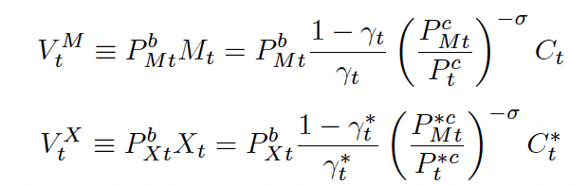
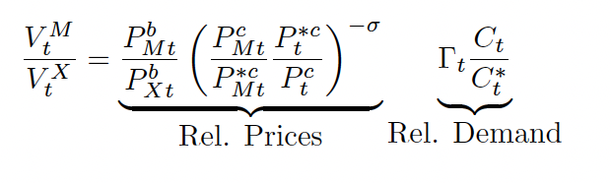
Some useful definitions
Current account balance (CA)
= Trade balance (TB) + Net factor income from abroad (NFIA)
Trade balance= Value of Exports-Value of Imports
Notes:
A current account deficit is not just a trade imbalance — it reflects a gap between domestic saving and investment and is financed by net capital inflows, which accumulate into the country’s net international investment position over time.
A positive NIIP means the country is a net creditor to the world; a negative NIIP means it is a net debtor

Slide 9
IMF: Global excess CA balances rose in 2025
+0.7pp
largest increase in the past decade
Excess CA (IMF) = CA – CA (fundamentals, sound policies)
Source: IMF ESR 2026
Note: (1) ESR economy GDP

Slide 10
The increase in China’s current account has been primarily driven by a decline in investment. For US: fiscal deficits+AI
Source: IMF External Sector Report (2026)

Slide 11
Proposal 1: Domestic macro adjustments
 | What is needed: simultaneous macroeconomic policy actions in major economies US: reduce public deficit China: increase public support for healthcare, safety nets and scale down unwarranted industrial policies EU: deepen integration of goods and services markets and further capital market integration (Draghi Report)
Addressing global
imbalances
Report by Bai, Gopinath, Rey, and Weber (March 2026)

Slide 12
Simultaneous domestic policy adjustments can expand world output and narrow global current account imbalances – IMF simulation
Medium-term¹ impact of domestic adjustments on…
Source: IMF External Sector Report (2026)
Note: (1) Three to five year horizon

Slide 13
Impact of China-only adjustment
Source: IMF External Sector Report (2026)

Slide 14
Proposal 2: Revalue the yuan. Plaza Accord
Source: BIS, FRED

Slide 15
IMF: China’s yuan undervalued. Devil in the details
Illustrative case from the latest IMF ESR
3 methods to estimate Real Effective Exchange Rate (REER) gap used by the IMF | China - latest estimate | What it measures
REER gap implied by the CA gap | (21.3%) | It estimates the adjustment needed to close the CA gap, holding all else equal, not a statement that the ER is the problem
REER Index gap | (2.7%) | It estimates whether the FX is misaligned relative to its own historical relationship with country-specific fundamentals and policies
REER Level gap | 0.5% | It estimates whether the FX rate is misaligned relative to a benchmark level predicted by cross-country differences in fundamentals, structural characteristics and policies
There is no single “correct” estimate of FX over/under-valuation: each methodology relies on a different empirical approach, which is why the IMF considers all three in its assessment.
Source: IMF External Sector Report (2026)

Slide 16
Theory and empirics both have mixed (unclear) assessment for the current account. Greater agreement that it is costly for the economy.
Adding trade barriers barely changes IMF (EBA) predictions of annual current account changes
Proposal 3: Tariffs
Source: IMF ESR 2026

Slide 17
Proposal 4: Industrial policies improve current accounts when they fail.
 |  | Direction of productivity shock
 |  | Positive | Negative
Time Horizon | Temporary | CA ↑ | CA ↓
 | Permanent | CA ↓ | CA ↑
Source: IMF POLICY PAPER “UNDERSTANDING GLOBAL IMBALANCES” (April 2026)

Slide 18
Mixing up global imbalances and sectoral imbalances
Sectoral imbalances do not drive global imbalances, but their concentration in strategic industries can fuel protectionism and heighten national security concerns
Source: IEA
Notes:
In 2025, exports reported by CAAM exceeded overseas sales by over 25%, suggesting a significant increase in overseas inventories, likely constraining additional shipments. Policy developments are adding further constraints.

Slide 19
Managing sectoral imbalances
 | What is needed: Pragmatic trade governance Enhance safeguards mechanism of the WTO Strengthened financial oversight, and enhanced information sharing
Managing sectoral
imbalances
(goods and services trade
+ financial sector)
Report by Bai, Gopinath, Rey, and Weber (March 2026)

Slide 20
Proposal 5: Degrade dollar’s reserve currency status
Obstfelf (2026) Peterson Institute piece.
Convoluted argument: High foreign demand to hold dollars as reserves and therefore the US needs to on net supply dollars to the world which it does by buying more goods from the ROW than the ROW buys from it.

Slide 21
How to address global imbalances? Lining up the proposals
1 | 2 | 3 | 4 | 5
Domestic macro adjustments | Revalue Yuan (Plaza accord) | Tariffs | Industrial Policy | Degrade dollar’s reserve currency status
Holds up to scrutiny. In both country’s individual interest | Gimmicky | Bad idea | Bad idea | WTH

Slide 22
Recent US policy decisions have had little effect on trade balances
Source: IMF BOP, BEA, SAFE

Slide 23
II. If not tackled…
Protectionism/Fragmentation

Slide 24
The Great Reallocation: trade is reorienting
Source: Antras, Pol, Adrian Kulesza, and Andrea Presbitero. 2026. “The Remains of the Trade: The U.S.–China Trade War and Its Aftermath.” Trade Data Monitor
Note: Graphs built with TDM data for this presentation.

Slide 25
The Great Reallocation during Trump II
US Presidential election
Source: Antras, Pol, Adrian Kulesza, and Andrea Presbitero. 2026. “The Remains of the Trade: The U.S.–China Trade War and Its Aftermath.” Trade Data Monitor
Note: Graphs built with TDM data for this presentation. Series show US goods imports from each partner, indexed to Nov. 2024 = 100. Values are a 3-month centered moving average (month t equals the average of t-1, t, and t+1)

Slide 26
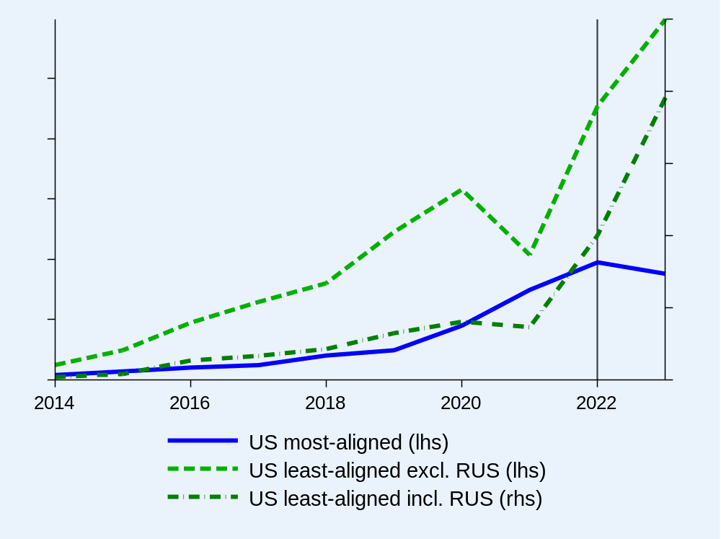
Dollar dominance mostly unchanged. The Ukraine war was a turning point but changes are small
Renminbi invoicing share (in %)
Source: Boz, E., A. Brüggen, C. Casas, G. Georgiadis, G. Gopinath and A. Mehl (2026), “Patterns of Invoicing Currency in Global Trade in a Fragmenting World Economy”, Working Paper, April 2026

Slide 27
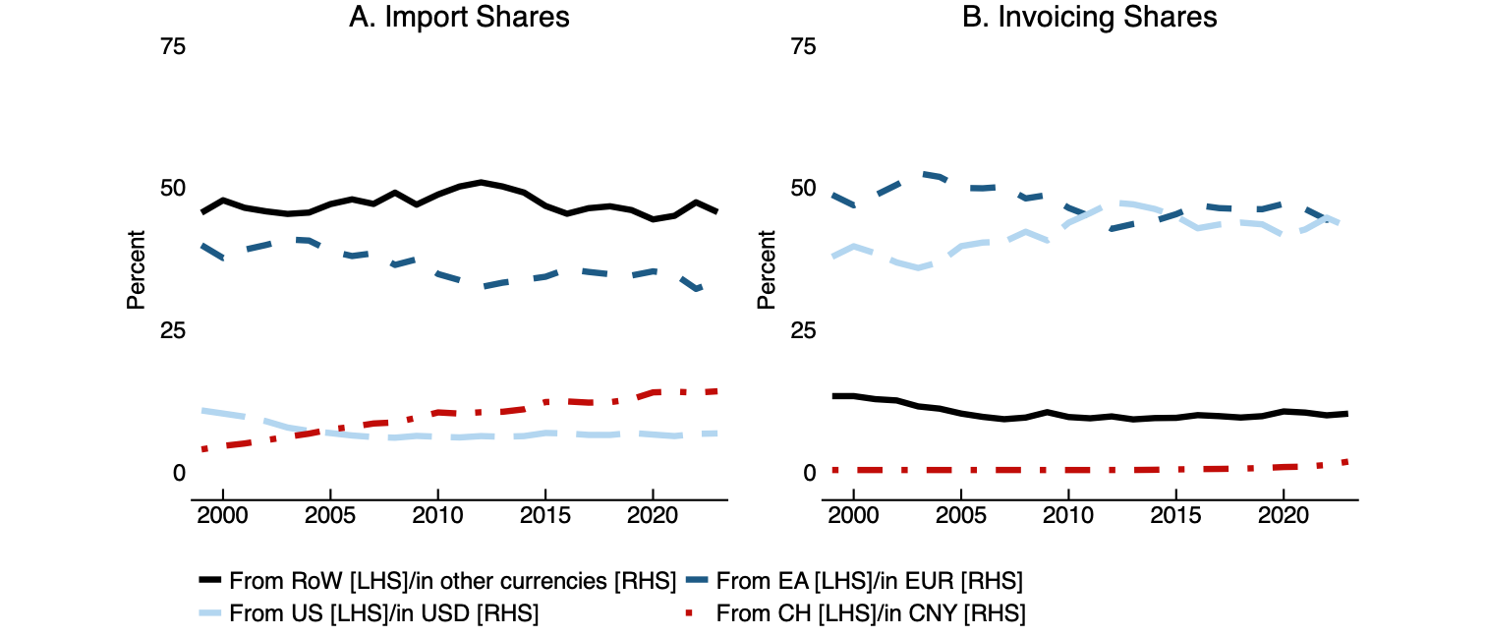
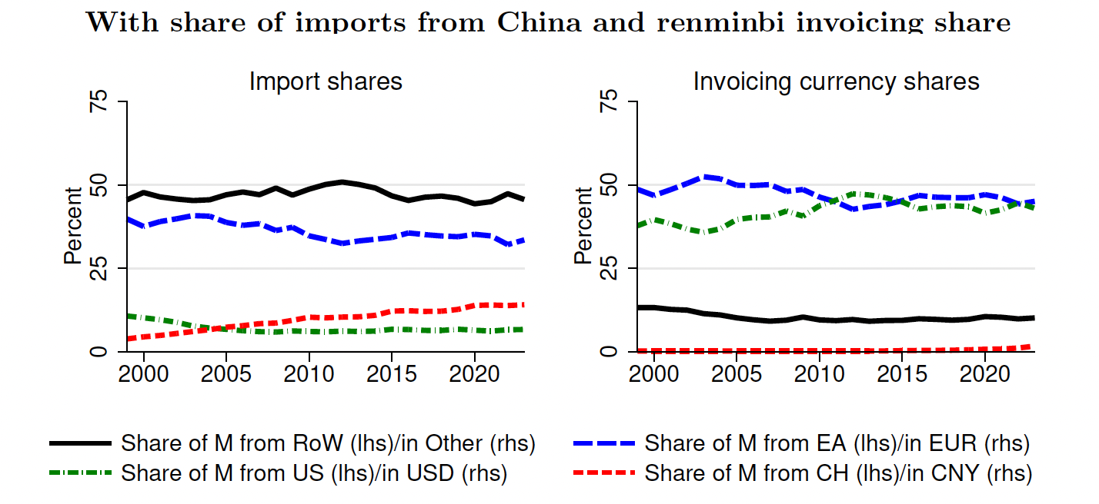
While imports from China have grown, renminbi invoicing remains tiny
Source: Boz, Brüggen, Casas, Georgiadis, Gopinath, and Mehl (2026)

Slide 28
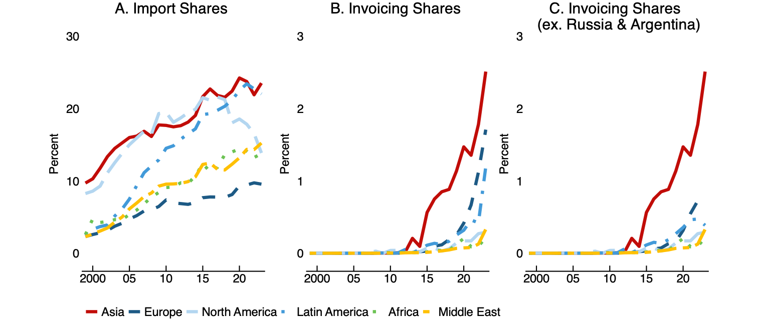
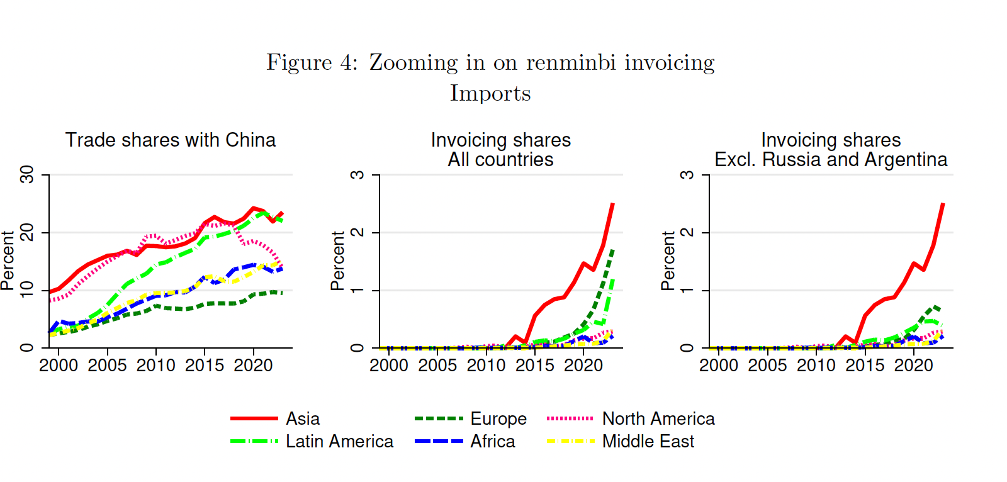
Renminbi usage has especially climbed in trade with Asian countries, Russia, and Argentina
Source: Boz, Brüggen, Casas, Georgiadis, Gopinath, and Mehl (2026)

Slide 29
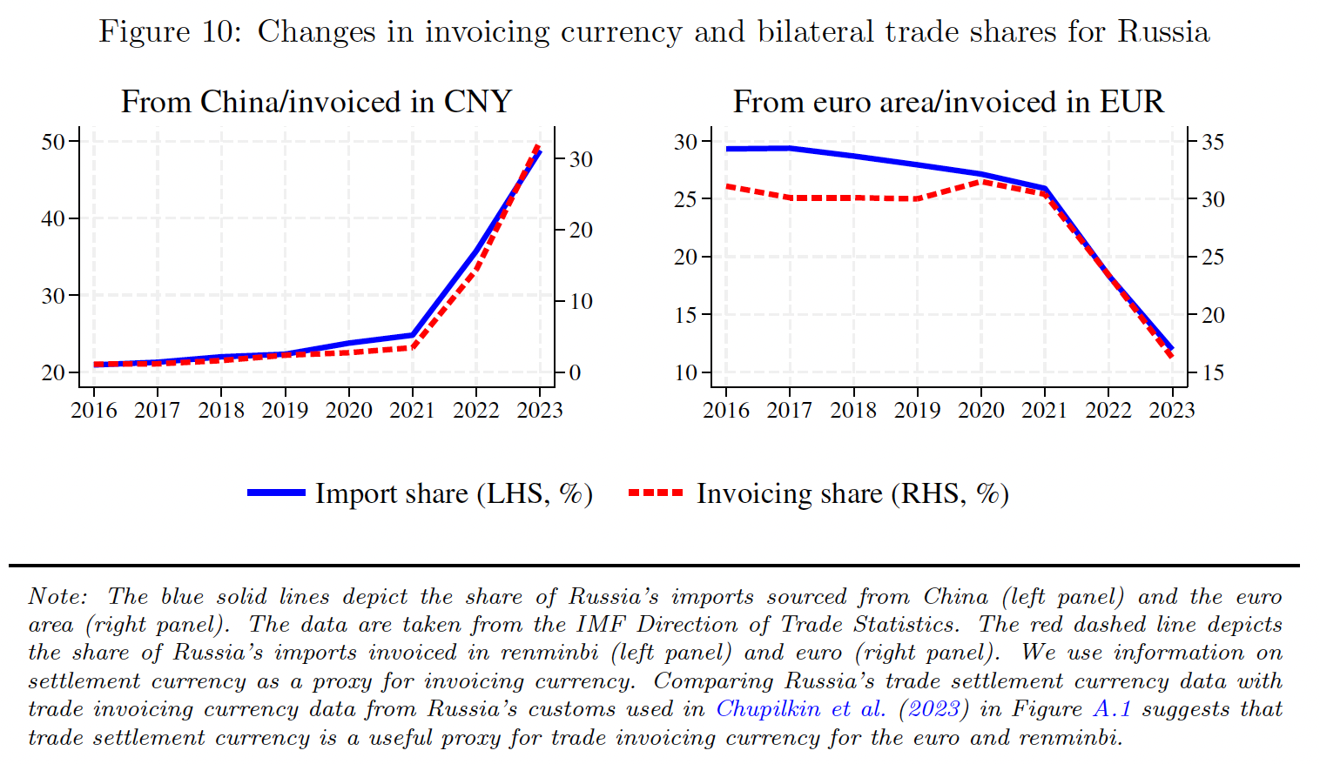
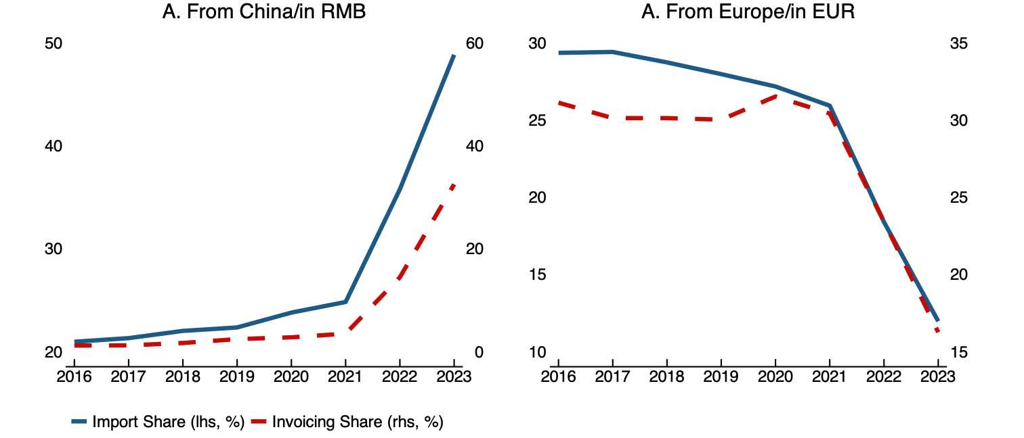
Russian trade pivoted away from Europe and towards China
Source: Boz, Brüggen, Casas, Georgiadis, Gopinath, and Mehl (2026)

Slide 30
III. Financial Risks of this Third Wave?

Slide 31
Net International Investment Position (NIIP)
= External assets – external liabilities
= cumulative CA + cumulative KA + valuation effects

Slide 32
The recent deterioration in US NIIP has little to do with trade deficits
61%
of the deterioration in NIIP driven by valuation effects since GFC
Source: US Treasury, Federal Reserve

Slide 33
Sources of financial fragility: concentrated exposure to US assets
$33.9tn
(36% of world GDP excl. US)
Gross foreign holdings of US equities
Source: US Treasury

Slide 34
Sources of financial fragility: rising US government indebtedness
54%
Share of gross foreign inflows into US government debt since 2007
Levered intermediation migrated to NBFIs
Source: Federal Reserve, FRED

Slide 35
Sources of financial fragility: fiscal concerns extend beyond the US
Yields in highly indebted countries have risen to their highest levels in a decade.
Source: Federal Reserve, FRED

Slide 36
Fragility has rotated
 | Pre-GFC (2007) | Today
Where leverage built | Households, banks | Governments, NBFIs
Asset bubble | Housing (US) | Tech/AI equities, some private credit
Triggers | Subprime MBS, inflation | AI bust, inflation
Outcomes | Banking crisis, sovereign debt crisis (EU) | Stock market wealth destruction or credit crunch; safe asset shock

Slide 37
To conclude
To address global imbalances: Get domestic macro policies right.
          - US reduces fiscal deficits
    - China rotates to consumption led growth (fix property sector, strengthen rural social safety nets)
What does not help: A new Plaza accord.
To address sectoral imbalances: Enhance WTO safeguard mechanism. Financial sector oversight in the US.
In the near-term imbalances could get worse: Owing to surging AI investment in the US and continued weak domestic demand in China.
1
2
3
4

